Slide 1
Procedures for Hiring Faculty at UNC Charlotte
September 11, 2024
Maxwell Awando

Slide 2
Introduction
Why is the faculty hiring process so complicated?
Subject to state and federal laws
Subject to audits
Accreditation
Decentralized Hiring Process

Slide 3
Questions about best practices?
Office of Legal Affairs – Review Employment Guidelines
Office of the Provost Website - Academic HR Procedures Handbook
Center for ADVANCing Faculty Success - Best practices for advancing faculty recruitment

Slide 4
Faculty Recruitment

Slide 5
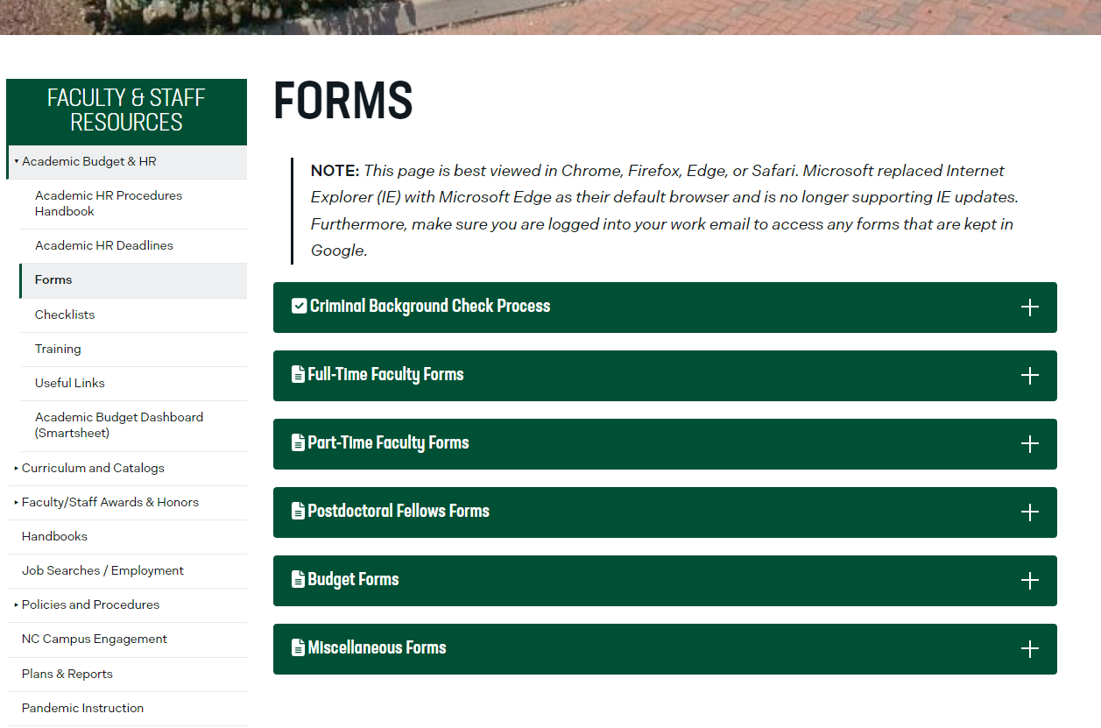
https://provost.charlotte.edu/academic-budget-hr/forms/

Slide 6
Faculty Hiring & NinerTalent
Three step process
Position Description Updates / Modify
Posting
Hiring Proposal
https://jobs.charlotte.edu/hr/sessions/new

Slide 7
Preparing for Recruitment
Receive authorization to recruit from Dean
Department Chair appoints and charges search committee
Initiator reviews, updates and forwards the position description for approval in NinerTalent.
Position Description is approved in NinerTalent by:
Department Chair (if not Initiator)
Dean
Academic Affairs HR

Slide 8
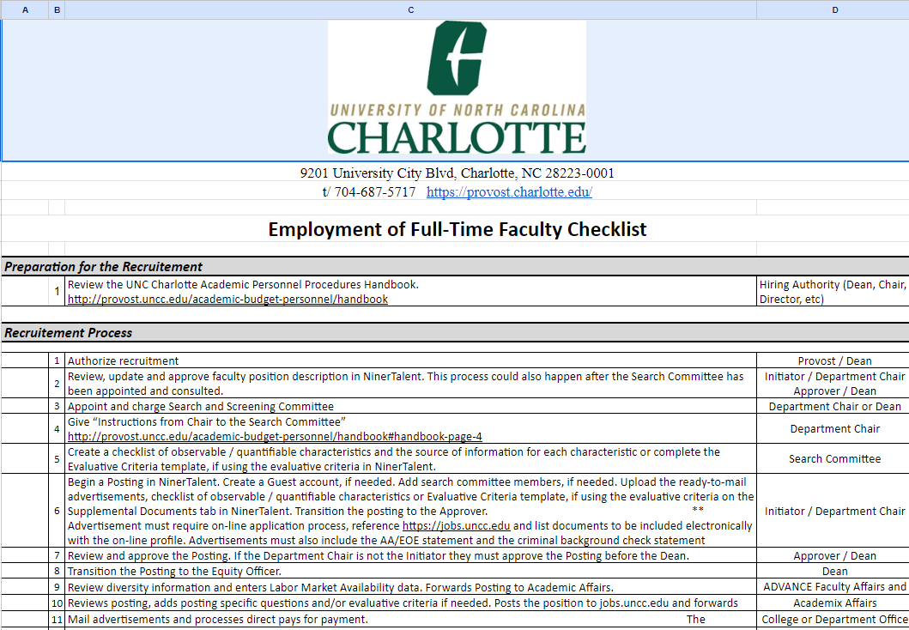
Faculty Hiring Checklist

Slide 9
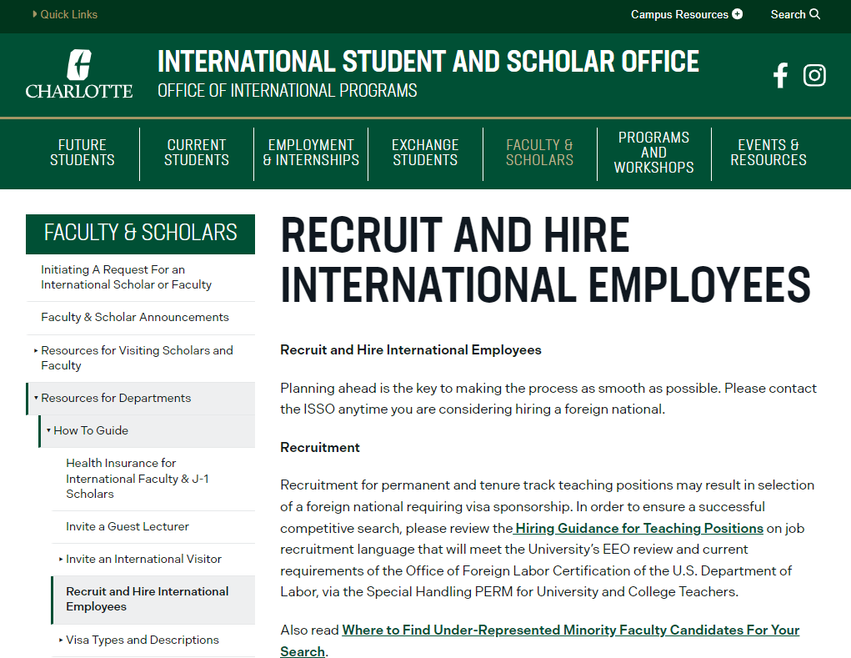
Recruit and Hire International Faculty

Slide 10
Faculty Position Description
Position Descriptions
Faculty – Active Position Descriptions
Faculty -- View position library
Faculty Position Requests – View all position description actions (in process)
Notes:
The position management module has a orange theme.
There are two menu items, Position Descriptions, and Classifications.
review current pending and approved position descriptions in your department and/or division.
If you don’t use your Inbox to locate the action that needs your attention, chose Faculty Position Requests
Filling a vacant line go to Faculty
To initiate a new faculty position description that has been allocated

Slide 11
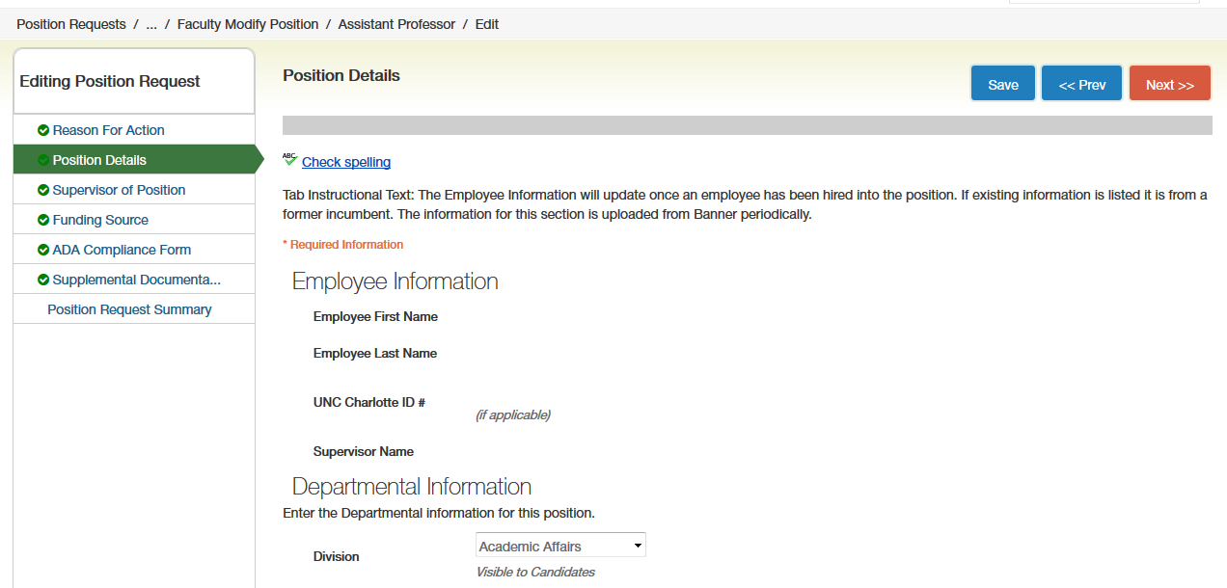
Faculty Position Description
Click Next to move to next tab
Position Description Navigation Menu
Enter details in fields

Slide 12
Faculty Position Description
Transition to the next step in the workflow
Workflow options will vary based on user group
Notes:
Once Initiators have completed the form they will move the PD in the workflow to an Approver.
The look and feel is the same for Initiators and Approvers

Slide 13
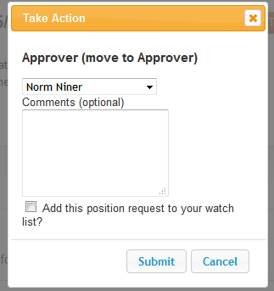
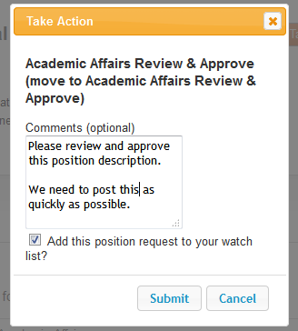
Faculty Position Description
List of Approvers
Comments are part of the official personnel file
Click Submit to move in workflow
Standard routing options are directed to the user group
Routing to Approvers is directed to an individual, which allows for more than one approver.
Please remember, once submitted Comments can’t be deleted.
Notes:
Group Member Prompt for Approver

Slide 14
Faculty Position Description
Faculty position description is routed through all the proper channels and approved by Academic Affairs HR.
Then move on to the 2nd step in the process

Slide 15
Recruitment of Faculty Position

Slide 16
Begin Faculty Recruitment
Begin a faculty posting in NinerTalent
Applicant Tracking System module
Choose the recently modified and approved faculty position description. The information in the position description carries over from the position description to the posting. No need for duplicate data entry!
Department Chair (if not Initiator) / Dean approves the posting
Notes:
Upload ready-to-mail advertisements and Checklist of Observable / Quantifiable characteristics or Evaluative Criteria template

Slide 17
Positing to External Website
Department post position to external advertisements
For external advertisements, use wording: Applicants must apply electronically at https://jobs.uncc.edu and attach vita (etc.) - A link to department website can be included to provide additional information.
Ad must include the criminal background check statement and submission of transcript of the highest earned degree
Notes:
Upload ready-to-mail advertisements and Checklist of Observable / Quantifiable characteristics or Evaluative Criteria template

Slide 18
Applicant Tracking System Module
Postings
Hiring Proposal
Common actions:
Creating a Posting
Hiring Proposal
Viewing Postings and Active Applicants
Notes:
The applicant tracking module has a blue theme
There are two menu items, Postings, and Hiring Proposal
This module is where a lot of time will be spent.

Slide 19
Create Faculty Posting
Create a new posting
Once position description has been approved the Initiator can create a new posting.

Slide 20
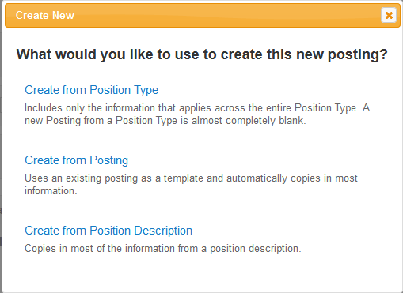
Create Faculty Posting
Not used for faculty postings
To duplicate another posting
Most Common: to create the posting from a position description
Initiator chooses what will be used to begin the posting.
Notes:
This training will continue as if we chose the Create from Position Description option.

Slide 21
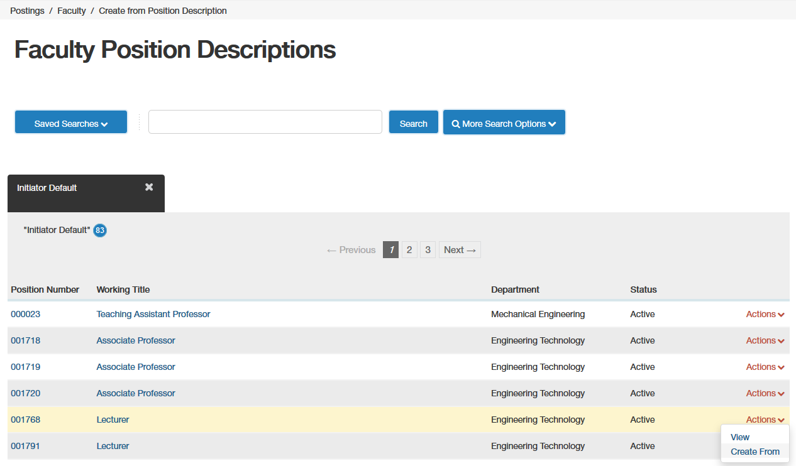
Create Faculty Posting
Text search box
Click Actions -> Create From
Locate the PD you want to use for the posting
Notes:
This training will continue as if we chose the Create from Position Description option.
System will let you know if there is an open action. Will say “View Posting” under Actions

Slide 22
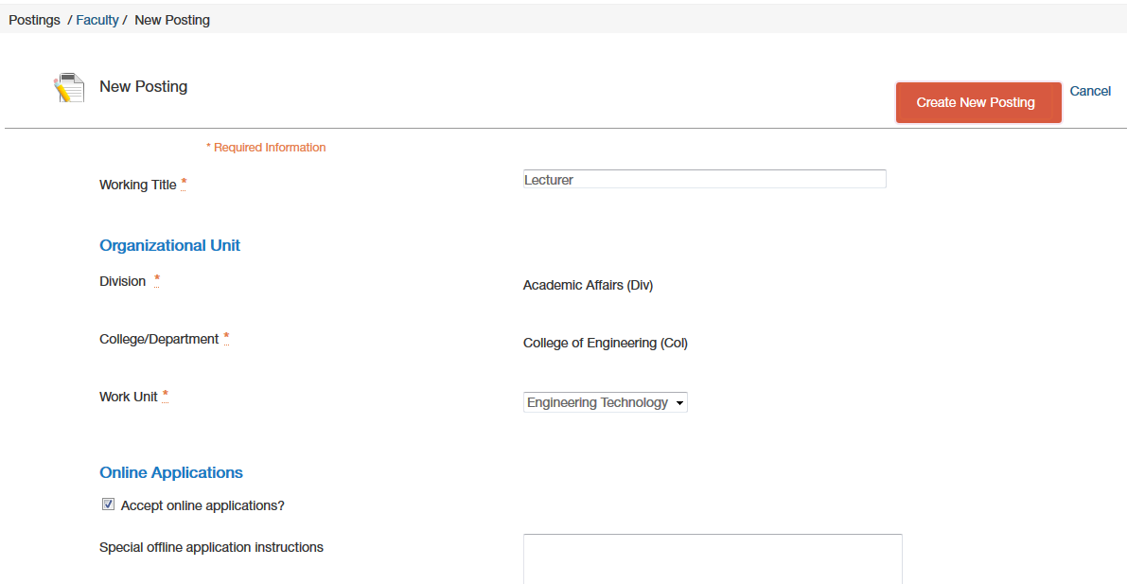
Create Faculty Posting
Click here to create posting
Settings Page sets up the work unit the position is associated with.
Settings Page sets up the work unit the position is associated with.
Notes:
This training will continue as if we chose the Create from Position Description option.

Slide 23
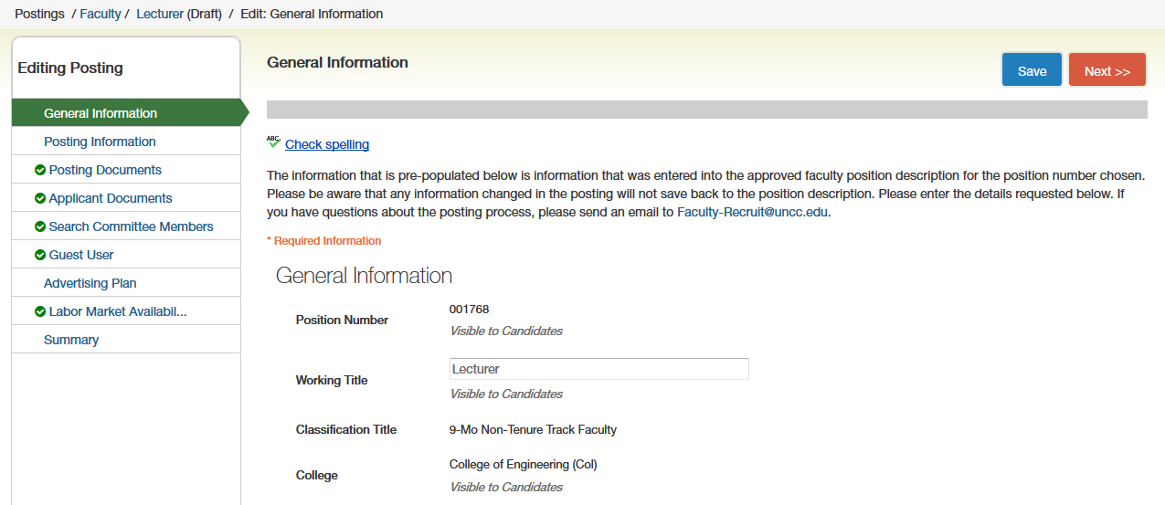
Create Faculty Posting
Click Next to move to next tab
Enter details in fields
Posting Navigation Menu

Slide 24
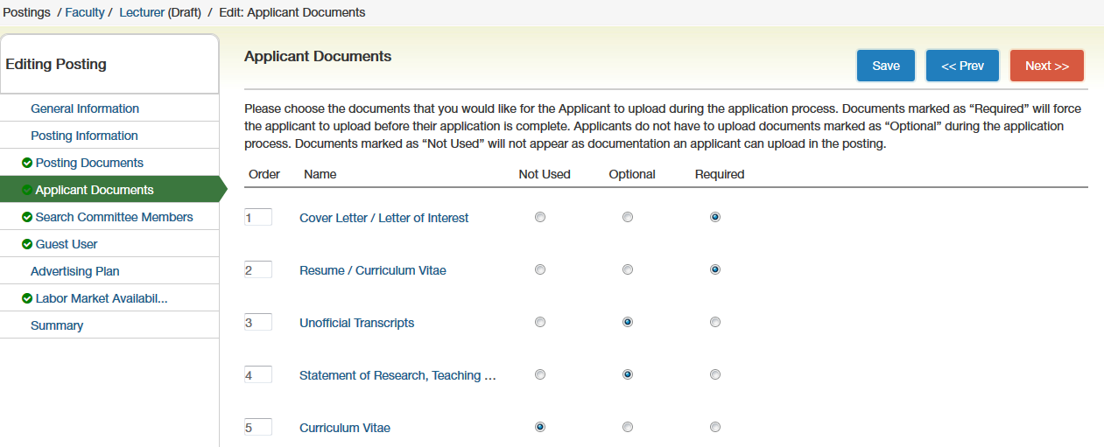
Applicant Documents
Choose whether the applicant documents have to be uploaded, optional or not used.
Can re-sort the list of documents
Notes:
Remember that the applicant must upload the required documents in order to be considered for the position.

Slide 25
Search Committee Member vs. Guest User Account
Two types of “guest” accounts in NinerTalent
Search Committee Member – Can log in with UNC Charlotte NinerNet credentials
Guest User Account – System generated login credentials
If someone needs Search Committee Member access, contact Courtney Webster, Tangia Betterson, Dawn Tench or Maxwell Awando

Slide 26
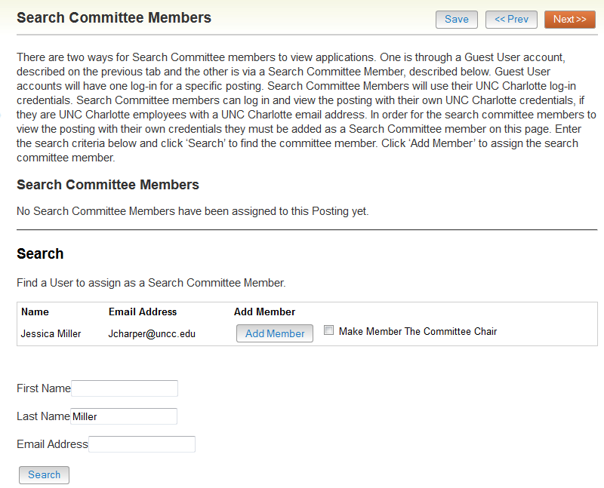
Search Committee Members
Are they the search committee chair?
Search for search committee members
Add the person as a search committee member
Used for on campus search committee members
Notes:
Search for Search Committee Members
Add the person as Search Committee member
Search Committee Chair?
NOTE: If a person doesn’t have search committee member access, they will show as “pending”.

Slide 27
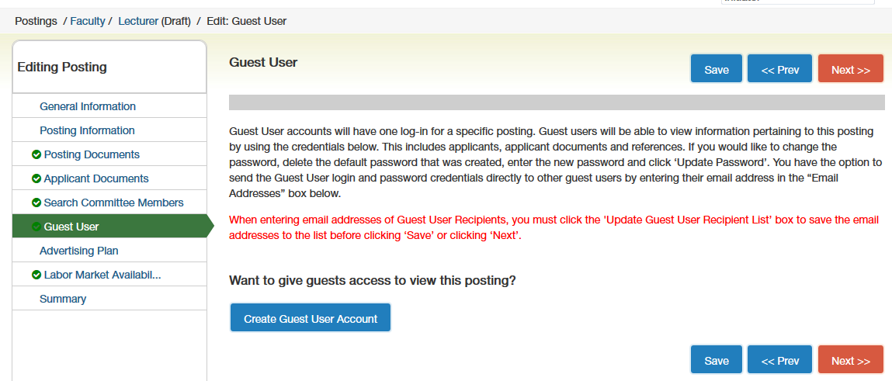
Guest User
Click to create a Guest User Account
Used for off campus search committee members

Slide 28
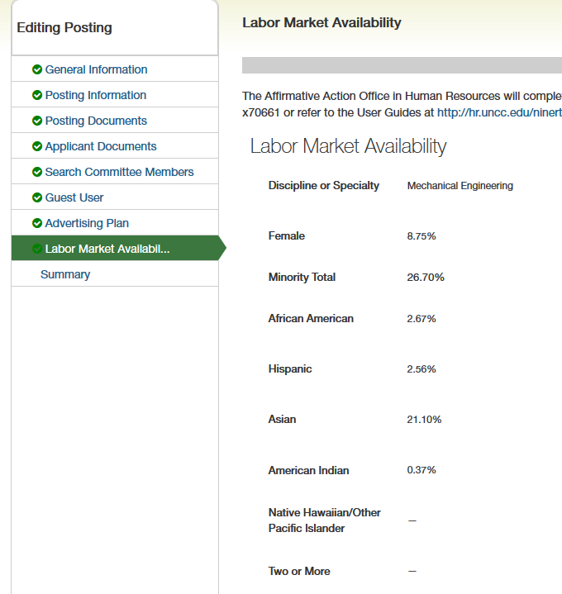
Labor Market Availability Data
The Equity Officer will enter the Labor Market information
You will compare the Labor Market information with the demographics of the applicant pool.
Notes:
The Labor Market information will be filled in by the Equity Officer after the posting is submitted to HR. Later on in the applicant tracking process, you will compare the Labor Market information with the demographics of your applicant pool. The comparison is made to ensure the applicant pool is in line with the Labor Market information.

Slide 29
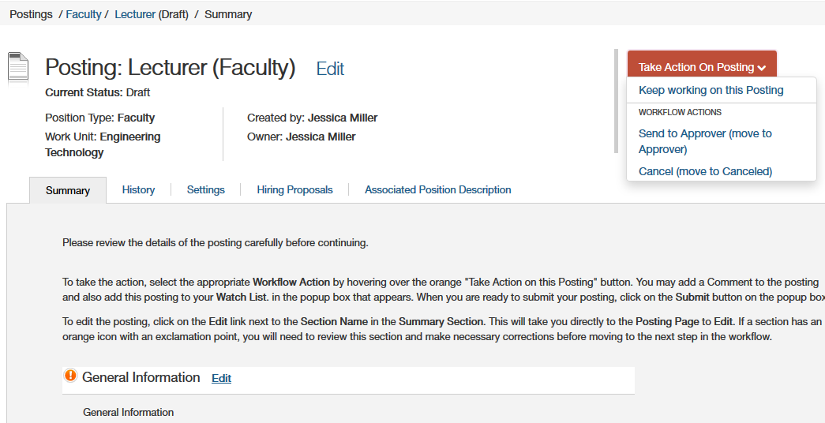
Create Faculty Posting
Transition to next step in workflow
Workflow options will vary based on user group
Notes:
Once the Initiator has completed the process they will route the posting to the Approver for their review
Approvers and Initiators have the same look and feel.

Slide 30
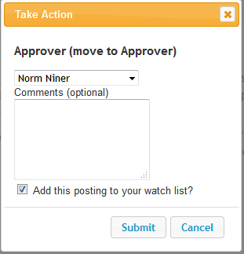
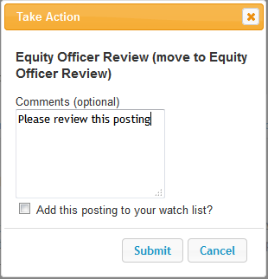
Create Faculty Posting
List of Approvers
Comments
Click Submit to move through workflow
Standard routing options are directed to the user group
Routing to Approvers is directed to an individual, which allows for more than one approver.

Slide 31
Reviewing Applicant Pool
How to review Applicants

Slide 32
Applicant Pool Best Practices
Change the applicants’ statuses as you go through the process.
It is important to update the applicant statuses to reflect what happened during the hiring process.
If someone does not meet the minimum qualifications, change their status to “Not Best Qualified”.
Notes:
You can start reviewing the applicants as soon as they apply. For example, if the position requires a Master’s degree and the applicant does not have a Master’s degree, you can go ahead and move them to “Not Best Qualified”.
If an applicant declines to be interviewed, make sure you choose the “Declined Interview.”
Every applicant who applies, needs to be reviewed to determine whether or not they are qualified.
The statuses need to accurately reflect where the applicant fell out of the recruitment process. This information will be looked at when we are subject to an audit by OFCCP (Office of Federal Contract Compliance Programs).

Slide 33
Applicant Pool Best Practices
Applicant statuses are considered part of the record of the recruitment process.
Before reviewing applicants, review the EEO report in comparison to the Labor Market data. (contact EPARecruitment@uncc.edu or the Equity Specialist x70661 for assistance)
All applicants MUST be reviewed
Notes:
You can start reviewing the applicants as soon as they apply. For example, if the position requires a Master’s degree and the applicant does not have a Master’s degree, you can go ahead and move them to “Not Best Qualified”.
If an applicant declines to be interviewed, make sure you choose the “Declined Interview.”
Every applicant who applies, needs to be reviewed to determine whether or not they are qualified.
The statuses need to accurately reflect where the applicant fell out of the recruitment process. This information will be looked at when we are subject to an audit by OFCCP (Office of Federal Contract Compliance Programs).

Slide 34
Faculty Applicant Statuses
Pre- Interview Status Options | When to use | Email Sent?
Further Consideration | Applicant who makes the “short list” | No
Not Best Qualified (Emails Applicant Now) | Applicant who does NOT meet the minimum qualifications | Yes, Immediately
Qualified, Not Selected | Applicant given Further Consideration status, but was not interviewed | Yes, When Filled
Under Review by Hiring Department | Applicant considered for review | No
Notes:
Explain why you would use each status. See list below.
Further Consideration: Short list of applicants who are qualified and may be recommended for interview and/or interviewed.
Not Best Qualified: Applicants who DON’T meet the minimum qualifications stated in the posting.
Qualified, Not Selected: Applicants who make it to the Further Consideration status, but do not get interviewed.
Under Review by Hiring Department: All Applicants considered for review and approval by the Dean. This status is given as soon as they apply

Slide 35
Faculty Applicant Statuses
Interview/Hiring Stage Status Options | When to use | Email Sent?
Declined Interview | Applicant approved for interview, but declined | No
Interviewed, Not Selected | Applicant interviewed but not hired | No
Offer Declined | Applicant interviewed, offered position but declined | No
Recommend for Hire | Applicant offered employment | No
Recommend for Interview | Applicant chosen by the Department to be interviewed | No
Approved for Interview | Applicant approved for interview by the Dean | No
Notes:
Explain why you would use each status. See list below.
Declined Interview: An applicant who was approved for interview, but declined after being contacted by the Department.
Interviewed, Not Selected: Applicants who are interviewed but not hired.
Offer Declined: Applicants who are interviewed and offered the position but decline.
Recommend for Hire: The Applicant for who an offer of employment will be extended.
Recommend for Interview: Applicants chosen by the Department to be interviewed.
Approved for Interview: Owned by Approvers and only used for Faculty positions.
The Dean will change applicants that were at a status of “Recommend for Interview” to “Approved for Interview” if they approve of having those applicants interviewed.

Slide 36
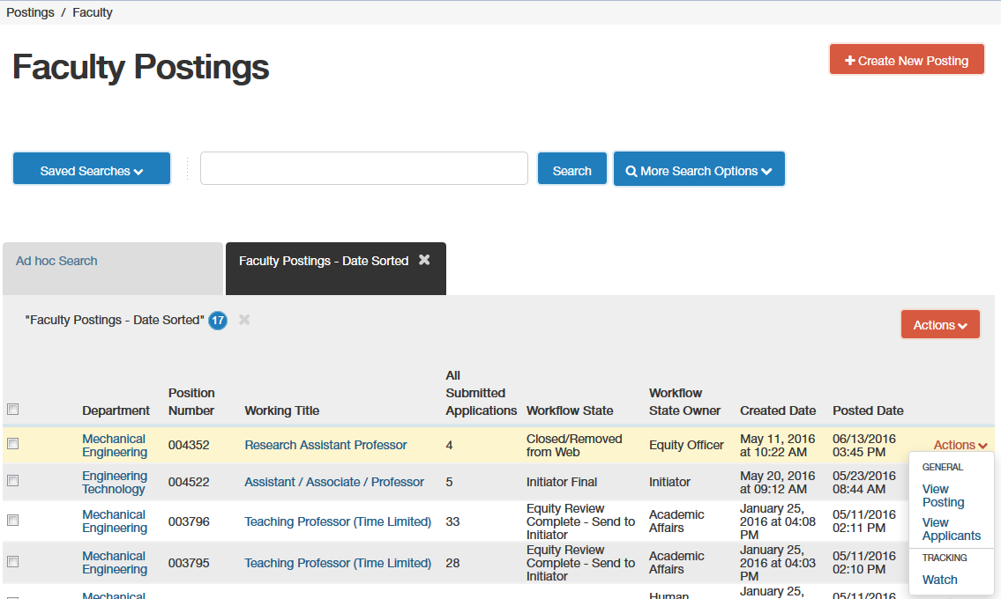
Viewing Faculty Applicants
Click Actions -> View Applicants
Notes:
When you log into the Applicant Tracking Module, you will be able to see the postings of your department.
Click the Actions button at the end of the row of the posting you wish to view, and then select “View Applicants”.

Slide 37
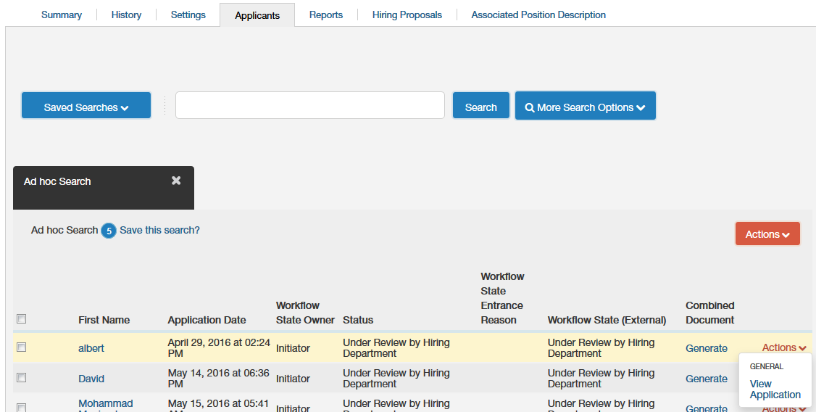
Viewing Faculty Applicants
Click Actions -> View Application
Notes:
Once the applicants for the position have opened, click the Action box at the end of the row.
Click on “View Application”.

Slide 38
Changing An Applicant Status
Transition to next step in the workflow
Refer to the User Guides for more information about when to use what status
Notes:
Click the drop-down arrow beside the “Take Action On Job Application” button to see a list of the “Workflow Actions”.
Then transition the applicant accordingly.
Both the Faculty and EPA Staff User Guides have more information about when to use what status.

Slide 39
REVIEWING MULTIPLE APPLICANTS
HOW TO REVIEW MULTIPLE APPLICANTS

Slide 40
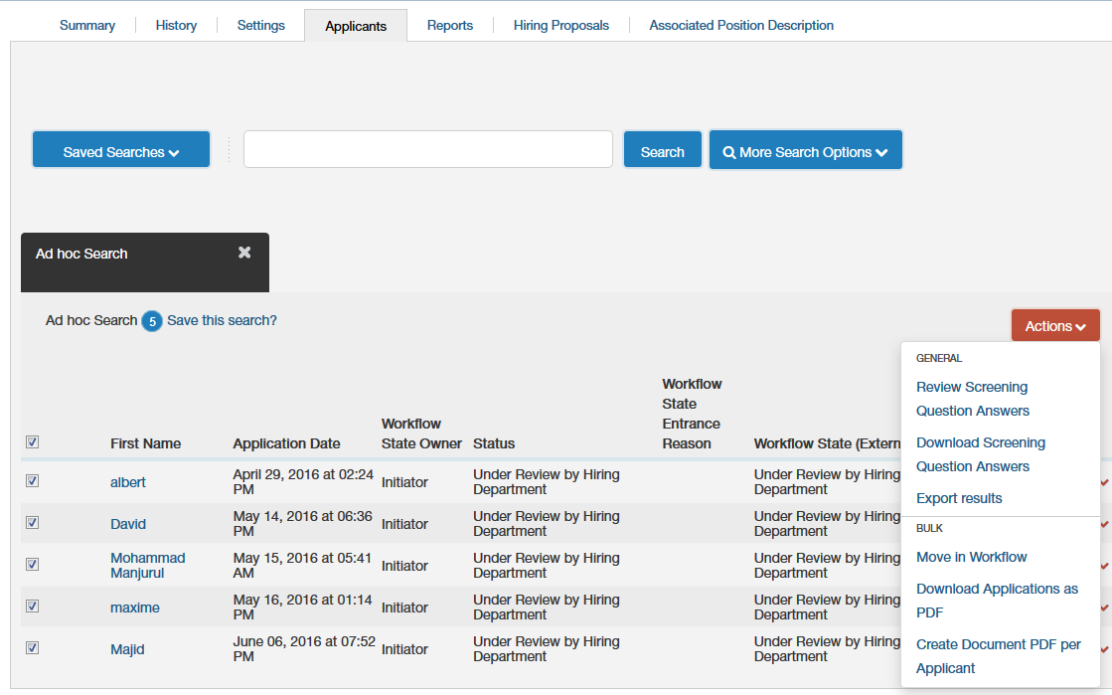
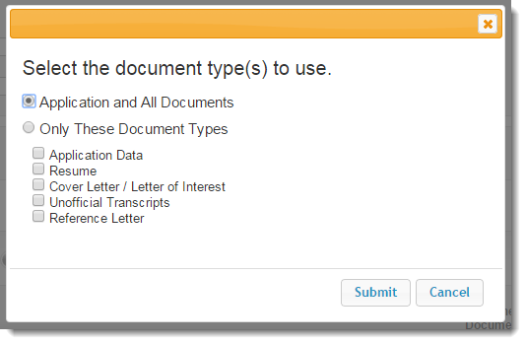
Viewing Multiple Applications at Once
Select all applicants
Click Actions
Select the documents to include
Click Submit to create a PDF of multiple applications
Notes:
You can create a PDF file that includes the applications and documents from all of the active applicants.
Click the box on the left hand side in the gray menu bar. This will check the boxes beside each name.
Click on Actions. Clicking the Actions button beings up the menu to the left.
“Download Applications as PDF” is the option you need to choose. Then you have the ability to select the document types you would like to view. The default option is “Application and All Documents”.
Click the Submit button. The PDF file will open in the same window. You can save the PDF to your computer or print it out. To get back to NinerTalent, use your Internet browser's back button.

Slide 41
Moving Applicants Status in Bulk
Check applicants whose status you wish to change
Click Actions -> Move in Workflow
Only click on applicants that you would like to move to the same status
Then click the Actions button at the top and select “Move in Workflow.”
Notes:
Click the box on the left hand side by the applicants you would like to move in the workflow.
You should only click on applicants that you would like to move to the same status.
Then click the Actions button at the top and select “Move in Workflow.”

Slide 42
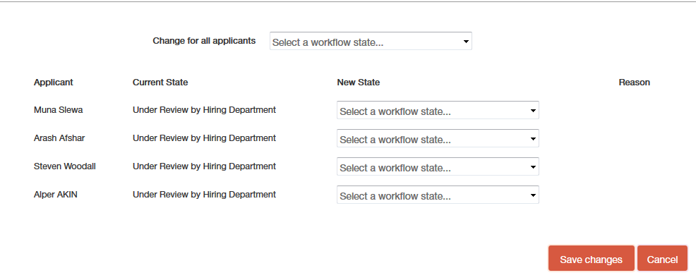
Moving Applicants Status in Bulk
Choose the Applicant Status
Click Save Changes when complete
Applicants have to be in the same status to move in bulk
Notes:
Then choose the workflow state from the drop down menu.

Slide 43
RECOMMENDED FOR INTERVIEW, NOW WHAT?

Slide 44
Preparing for Interviews
Search committee selects top candidates for interviews and submits list of selected candidates to the Director of Title IX Compliance for review and approval.
Prior to offering first-round interviews (or prior to offering a position if a search waiver applies), the initiator must provide a list of candidates selected for interviews to the Director of Title IX Compliance.

Slide 45
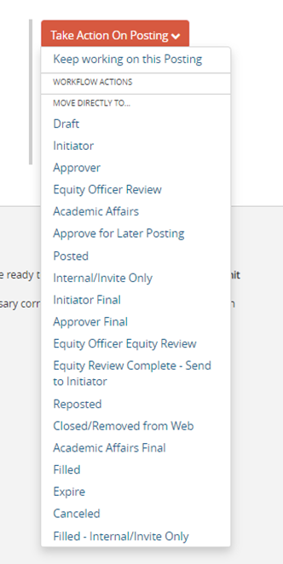
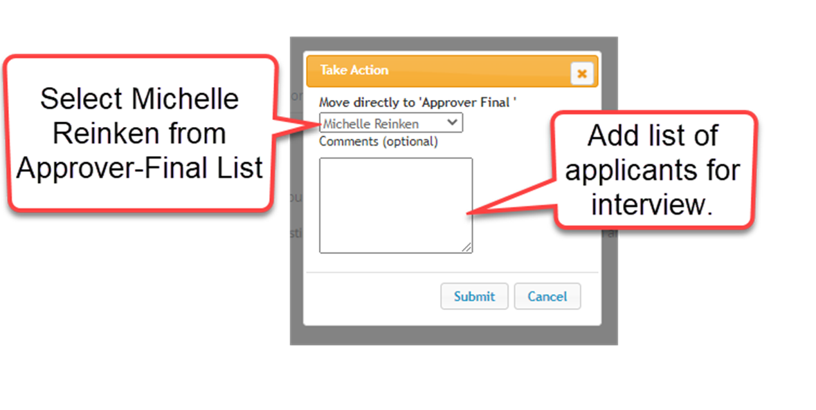

Slide 46
Preparing for Interviews
The Director of Title IX Compliance reviews list of selected candidates for interview and submits approval to Initiator via NinerTalent.
Department Chair (if not the Initiator) reviews candidates and forwards the posting to the next Approver.
If a top candidate is a non-resident, contact the Director of International Student/Scholar Office (ext. 7-7784)

Slide 47
Preparing for Interviews
The Dean, serving as the final Approver, will review the applicants in the status of “Recommend for Interview.” At this point, if the Dean agrees with the applicant statuses, the Dean changes the applicant statuses to “Approved for Interview” and will transition the posting to the Equity Officer.
Equity Officer will close the posting and review applicants to make sure they meet the minimum qualifications stated in the job posting transition the posting to the Initiator.

Slide 48
Interviews
At this point the department conducts the interviews and the Search Committee selects finalist

Slide 49
Hiring Proposal

Slide 50
Faculty Appointment
Once finalist is selected, department emails faculty-recruit@uncc.edu for Academic Affairs to initiate the criminal background check.
Criminal Background Checks must be processed pre-employment.
Hiring Proposal may be initiated in NinerTalent, at this time, for the candidate recommended for hire, but do not transition to next step until background check has been completed.

Slide 51
Hiring Proposal For Faculty
Start Hiring Proposal
Once the applicant status has been changed to “Recommend for Hire” start the Hiring Proposal.

Slide 52
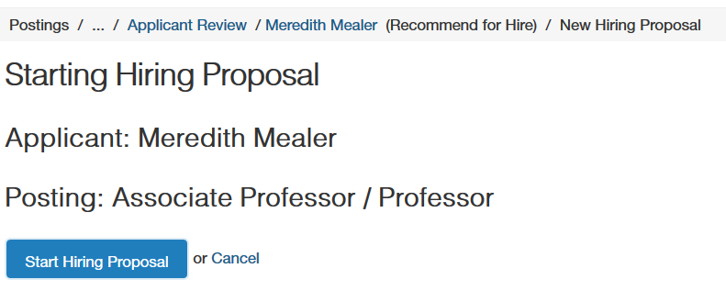
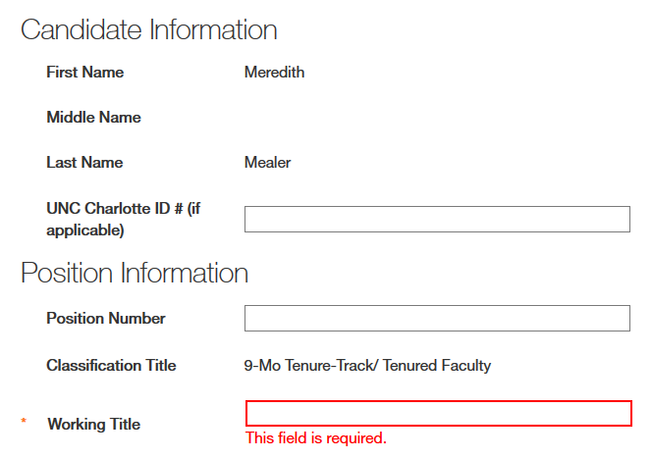
Hiring Proposal For Faculty
Click “Start Hiring Proposal”
Be sure to enter Position Number (with leading zeros – 00XXXX)

Slide 53
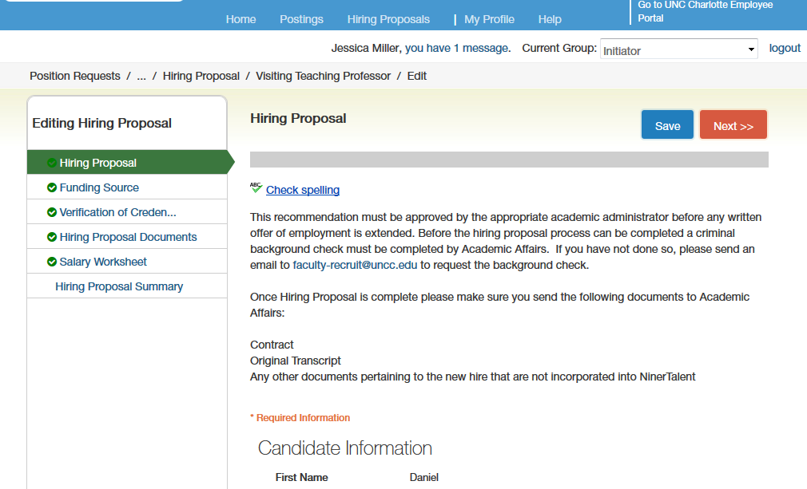
Hiring Proposal For Faculty
After details are entered click “Next”
Fill in details and click “Next”

Slide 54
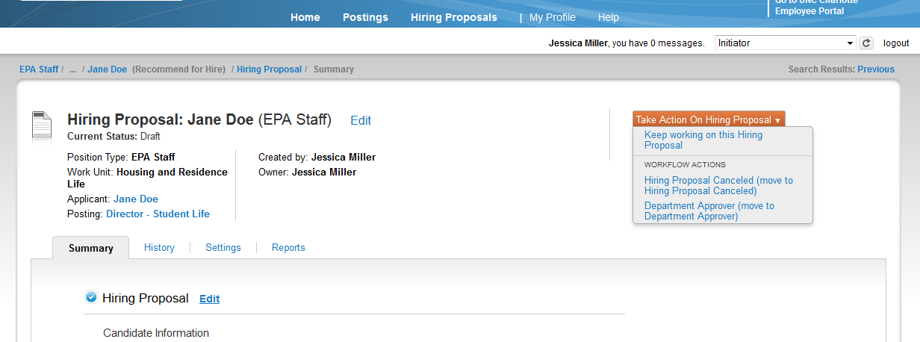
Hiring Proposal For Faculty
Associated Applicant and Positing
Transition to the next step in workflow
Transition to next step in the process

Slide 55
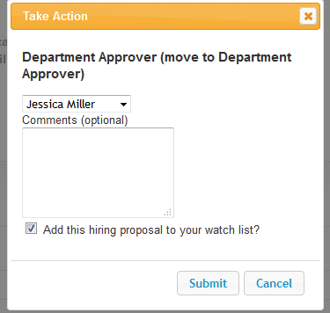
Hiring Proposal For Faculty
List of Approvers
Comments are part of the official personnel file
Click Submit to move through workflow
Standard routing options are directed to the user group
Routing to Approvers is directed to an individual, which allows for more than one approver.
Remember, once it is submitted the comments can’t be deleted

Slide 56
Hiring Proposal For Faculty
Upon approval of the Hiring Proposal, the Dean’s Office prepares and emails (or mails) Agreement for Appointment Assistant Professor (AA-09 or AA-14) and Special Faculty Appointment with cover letter to finalist.
The Provost makes the official job offer for Associate Professors (AA-10 or AA-11) and Professors (AA-13).

Slide 57
Faculty Appointment
The hiring department requests official transcript of highest earned degree. Transcript must be sent directly to the University. (Can’t be “Issued to Student” as candidate)
If highest earned degree is from a foreign institution, it will require an academic equivalency evaluation.
After finalist signs agreement, Dean’s Office sends complete file and transitions the Hiring Proposal to Provost’s Office.
Initiator changes the statuses of the remaining applicants.
Academic Affairs will approve and fill the posting when the hiring packet arrives in the office.

Slide 58
Complete File
Agreement (contract), AA-09 or AA-14
Official Transcript – Must be sent directly to University

Slide 59
NinerTalent Support
NinerTalent Website: https://jobs.charlotte.edu/hr/sessions/new
Email: ninertalent@uncc.edu
Academic HR Website: https://provost.charlotte.edu/faculty-staff-resources/academic-budget-personnel/

Slide 60
NinerTalent Support
Employment Category | Name | Phone Ext | Email
Faculty/SHRA | Maxwell Awando | 8621 | mawando@charlotte.edu
Faculty/SHRA | Courtney Webster | 5740 | cwebst15@charlotte.edu
Faculty | Dawn Tench |  | hftench@charlotte.edu

