Slide 1


Procedures for Hiring
Adjunct/Part-Time Faculty
June 2025
Franci Hamilton – Academic Affairs

Slide 2

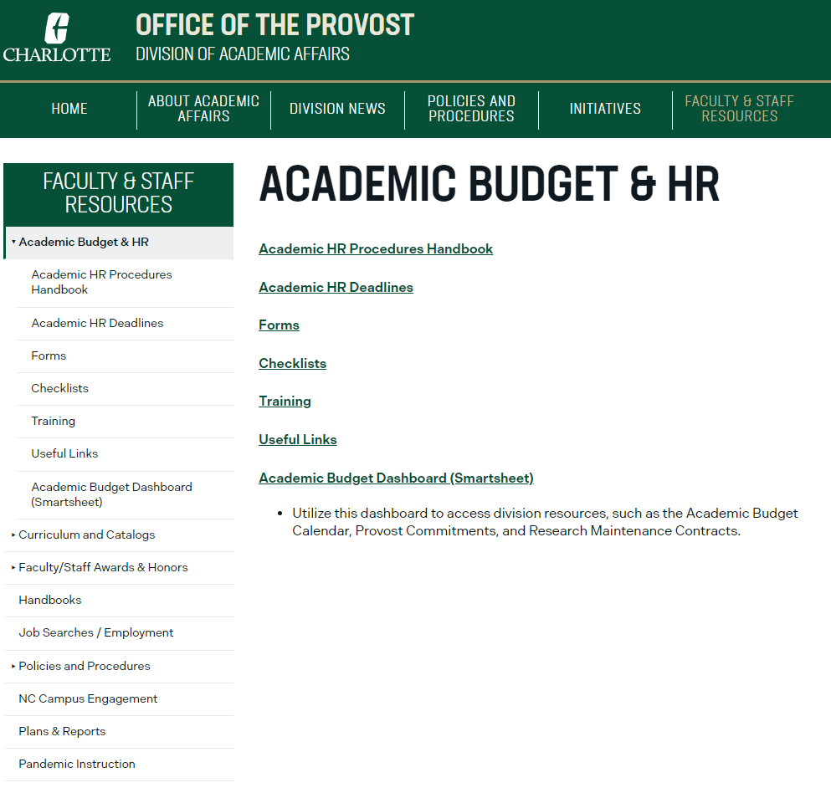
Academic Budget and Personnel Website
https://provost.charlotte.edu/academic-budget-personnel/academic-budget-and-personnel
Forms
Checklists

Slide 3
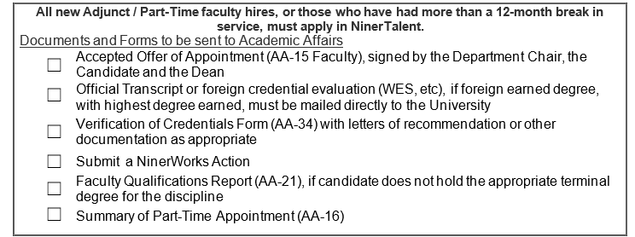
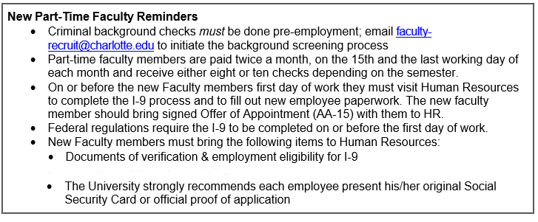

Faculty Recruiting Forms Checklist and Reminders

Slide 4
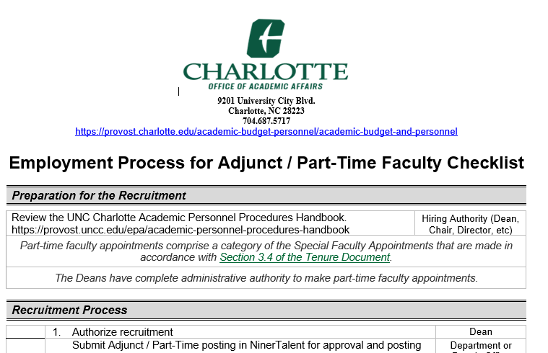
Fall & Spring Hiring Process Checklist

Slide 5
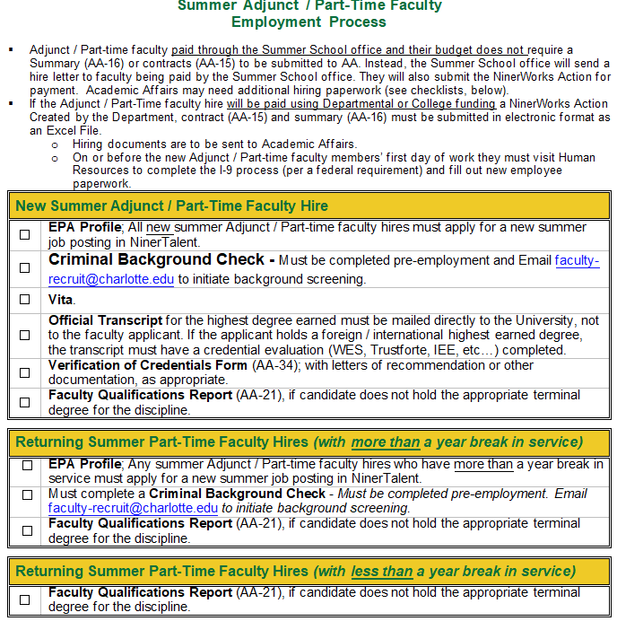
Summer Hiring Process Checklist
Payment questions for Summer Programs should be addressed to that office.
College Fund Supported PT Faculty Payments will need an AA-16 Summary for Summer

Slide 6
Begin Recruitment (NinerTalent Advertisement)
Department or College places advertisements
In NinerTalent (https://jobs.charlotte.edu/hr/) submit the Temp Hire posting for approval
Ad must include the following statement and the criminal background check statement
    “All finalists will be required to provide an official transcript.”
    “All finalists will be subject to a criminal background check.”

Slide 7
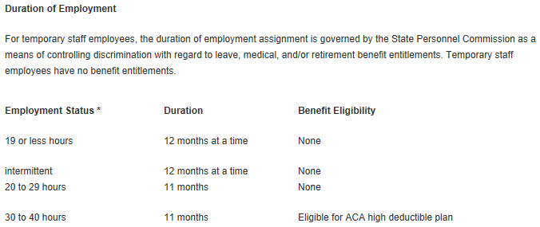
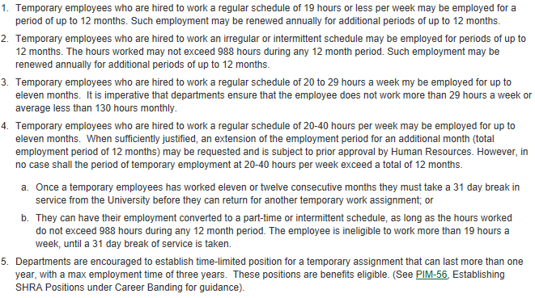
Personnel Information Memorandum (PIM 8)
https://hr.charlotte.edu/about-hr/personnel-information-memorandums-pims/pim-08-temporaryemployees
Faculty Assignments have built in Breaks

Slide 8
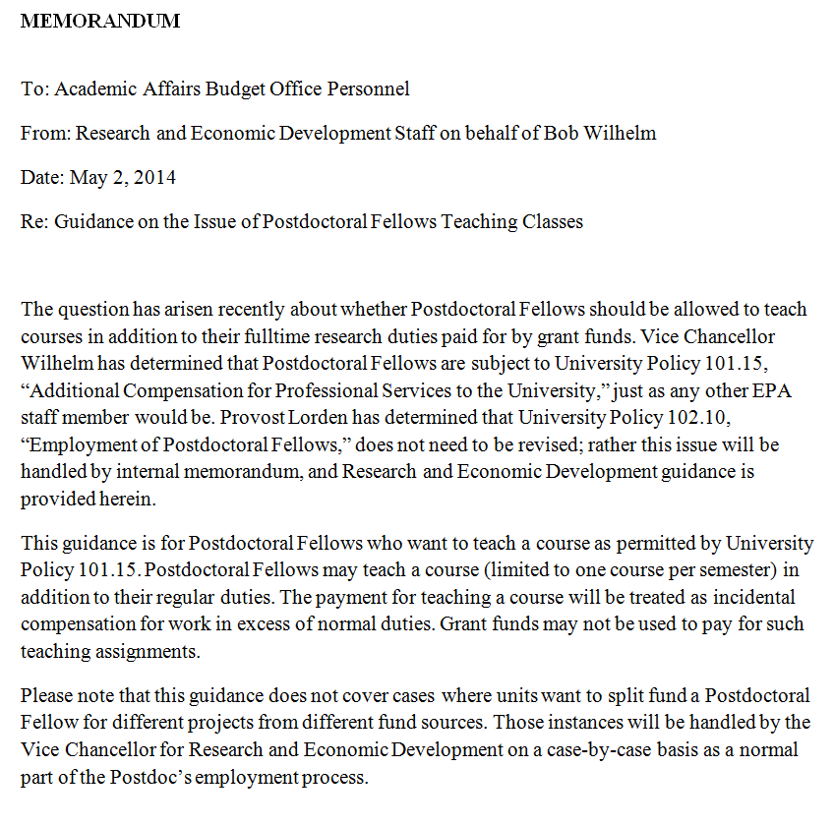
Postdoctoral Fellows with Part-Time Teaching Load
(1 Course Per Semester)

Slide 9
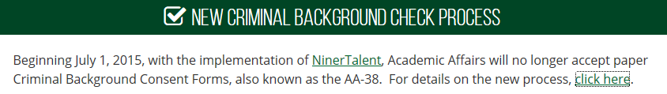
Criminal Background Check
Email the information below to faculty-recruit@charlotte.edu to begin the process:
  Faculty Applicant: Legal Name of the Final Candidate
  Faculty Type: Position Type (Full‐time Faculty, Part‐time Faculty)
  Department:
  Department Contact Name: (if different from person sending the email)
  These items are Important too:
  Department Org Code:
  Previous 800#
  Start Date or Semester they will begin Work for 800# activation
Submitted Pre-Employment
When is a criminal background check needed?
  New hire
  A returning faculty member who has not had one run previously
  A returning faculty member who has had a one year (12+ months) or more break in service

Slide 10
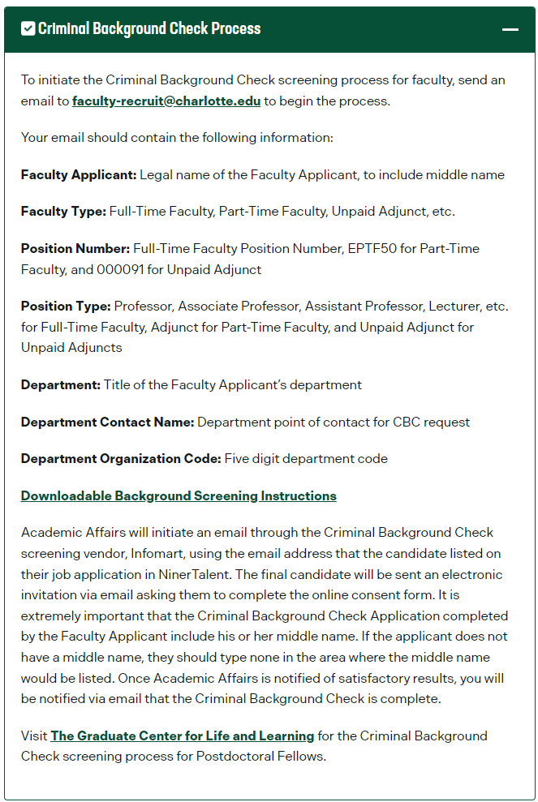
Background Check Instructions

Slide 11
Creation of Adjunct / Part-time Faculty UNCC ID
After Criminal Background Check Results have been reported to the Department, Academic Affairs will create the UNCC ID (800#) and email either the Department Staff or the Business Manager.
Notification will arrive through email, to the contact who submitted the Background Check

Slide 12
Prior to the New Faculty Member’s First Day
All hires should complete the new hire process and the I-9 before their first workday.
https://hr.charlotte.edu/employees/new-employees/before-you-start
Please bring all necessary forms of identification to complete this task
    If the chosen candidate is a non-resident, contact the Director of the International Student/Scholar Office. (ext. 7-7744)
    visit the New Employees webpage from Human Resources
    If you have questions about the I-9/hire process, contact Human Resources at 704-687-0669

Slide 13
Collecting Hiring Paperwork
Summary (AA-16) with all names (submitted to the College and the Faculty Recruit Email) in electronic Excel file format faculty-recruit@charlotte.edu
All new Adjunct/Part-Time faculty hires must apply in NinerTalent (re-hires with more than 1yr break in service must re-apply in NinerTalent) and must check that their I-9 is still valid in Human Resources
Response from Academic Affairs that the Criminal Background Check meets company standards.
Part Time Faculty Contract (AA-15 Powerform from the AABP Forms Page) (https://na3.docusign.net/Member/PowerFormSigning.aspx?PowerFormId=bb4c007c-1c18-4bee-82f8-ba87a67ee3fc&env=na3&acct=ee04da26-1433-4cfc-9888-fd1b5e8e0c60&v=2)
Vita/Resume should be in NinerTalent (no need to send it to Academic Affairs)
Verification of Credentials (AA-34), verifying Previous work experience
Letters of Recommendation (if required by College or Referenced in AA-34)
Official Transcripts (Must be original, sent directly to the University)
  If highest earned degree is foreign - Foreign Degree Evaluation (WES/Trustforte)
(AA-21) is only required if the faculty member does not have a degree in the field they are teaching or a terminal degree (see SACS 6.2.a) https://imaging.uncc.edu/imagenowforms/fs?form=Faculty_Qualifications_Form
Electronic (NinerWorks Action for Payment) https://ninerworks.charlotte.edu/

Slide 14
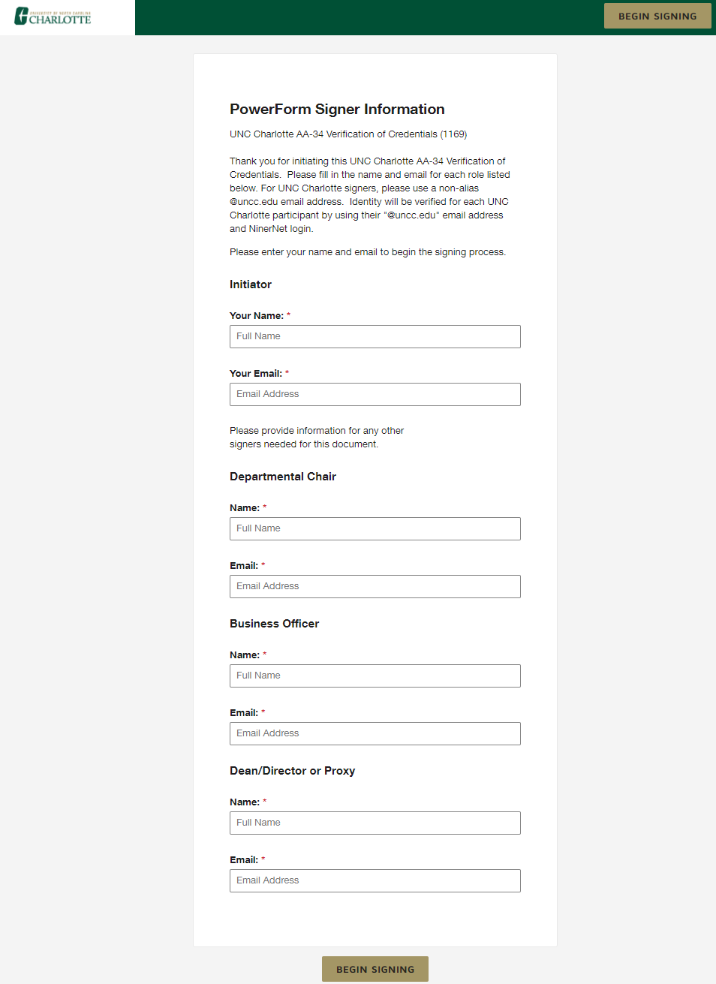
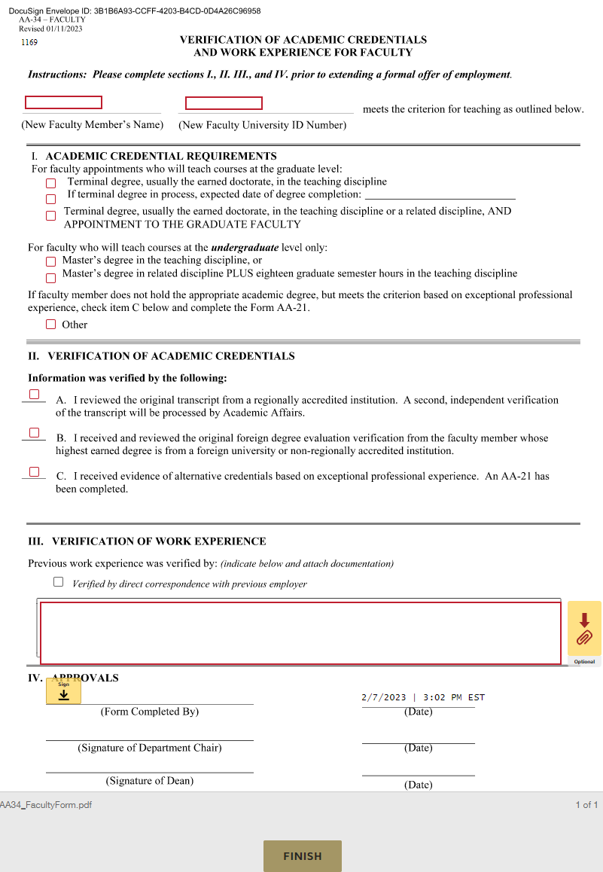
Verification of Credentials Form AA-34 Powerform
What is in an AA-34 Verification of Credential Form?
The AA-34 is a way to verify prior work experience for a new faculty hire.
  Section I: Educational Data necessary for teaching a course
  Section II: Review of the Transcript, Foreign Degree Evaluation or an AA-21 has been completed for Faculty with out a degree in the field being taught
  Section III: Note in the box how you verified the Prior work or job experience and use the paper clip to attach reference letters, reference emails or telephone reference check forms (who spoke to when and what did they say)
Complete Data in the Contract
  Faculty member first name and last name
  800# ID
  Check 1 box in Section I
  Check 1 box in Section II
  Check the box in Section III, fill in the box on how you are verifying the prior work experience and attach the Letters, emails or phone reference checks on the paperclip
  Have all the appropriate signature authorities sign this form and click finish
  Once the form is complete it will route to AA Personnel’s Image Now workflow queue for review
Files are reviewed by Internal Audit for compliance.

Slide 15
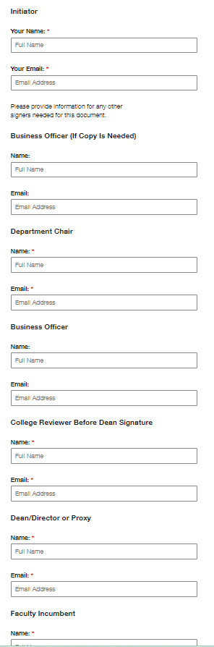
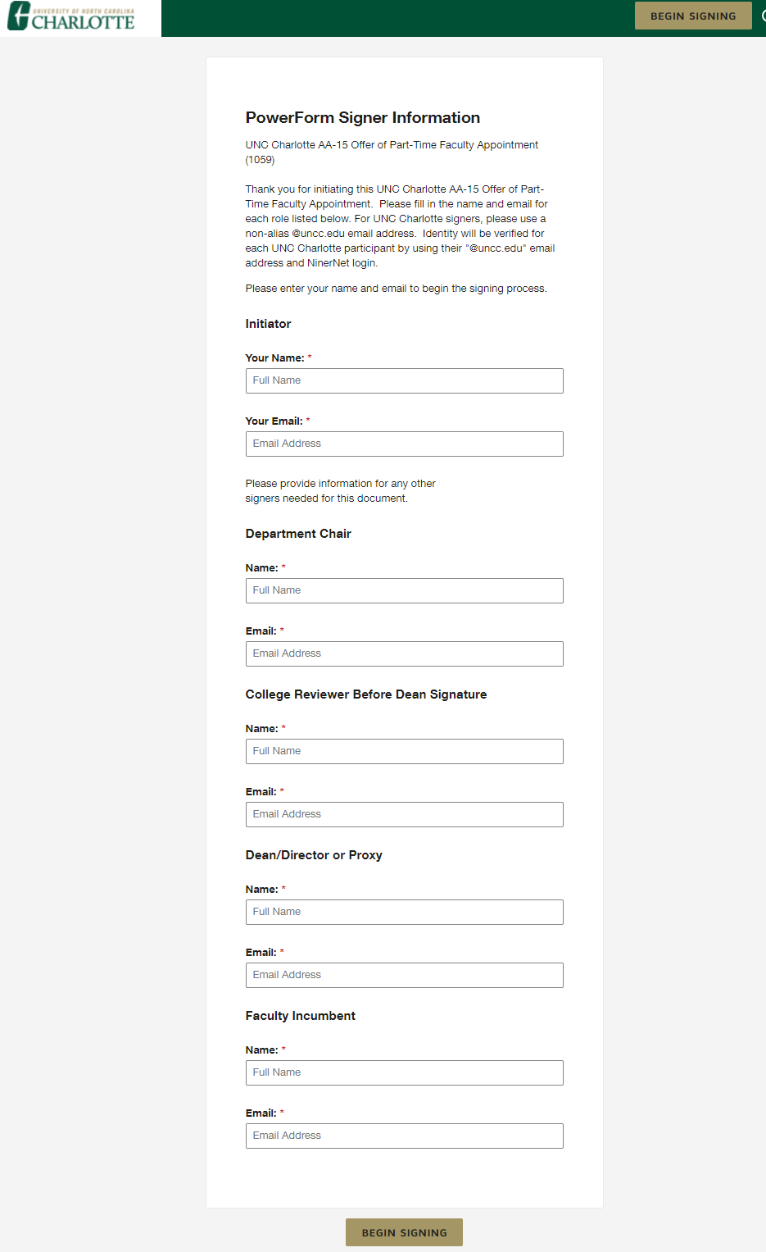
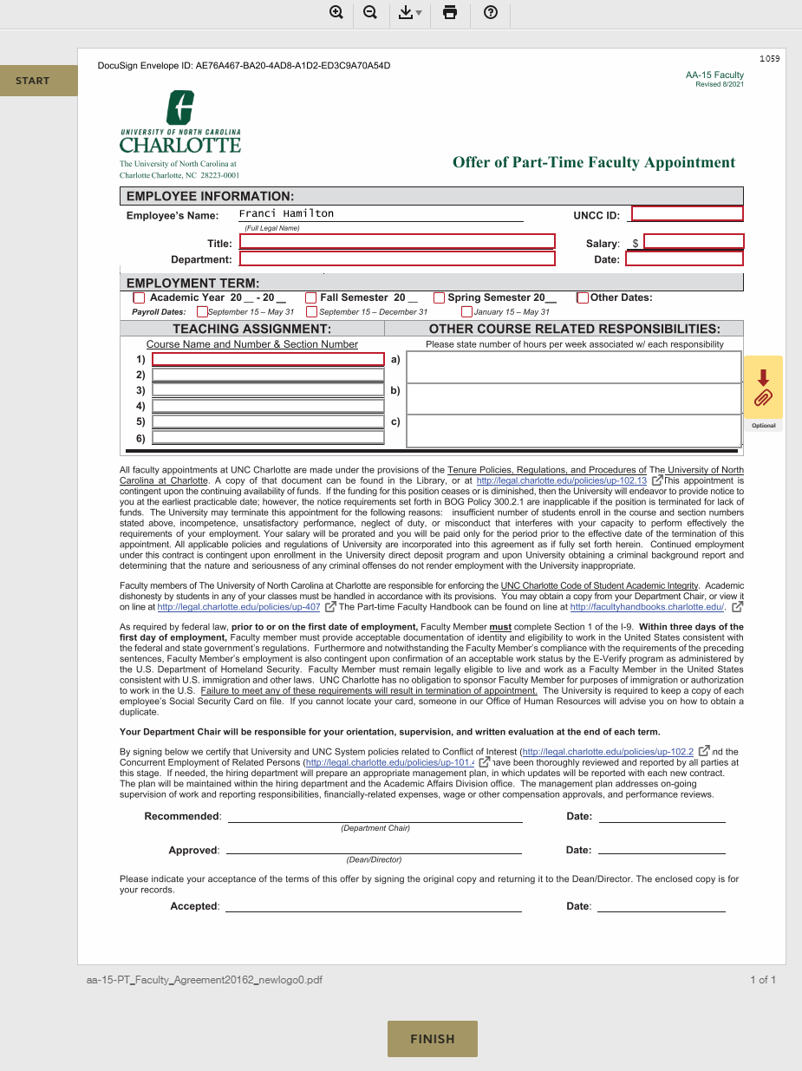
Part-Time Faculty Contract (AA-15 Powerform)
https://na3.docusign.net/Member/PowerFormSigning.aspx?PowerFormId=bb4c007c-1c18-4bee-82f8-ba87a67ee3fc&env=na3&acct=ee04da26-1433-4cfc-9888-fd1b5e8e0c60&v=2
What is in a Contract?
  Reasons To terminate
  Direct Deposit
  Criminal Background Check Statement
  I-9 Requirement
  Chair Responsible for PT Faculty Member Orientation
Complete Data in the Contract
  800# ID
  Title
  Hiring Department
  Salary
  Date the form is completed
  The Year or Term of Appointment or if Other Dates Apply
  All of the course prefixes numbers and sections being taught
  Attach any documentation needed

Slide 16
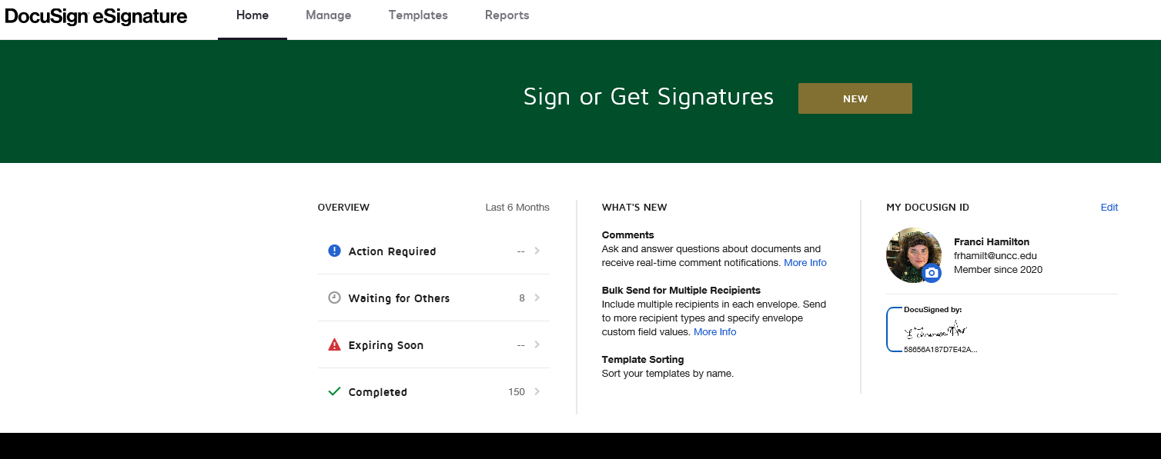
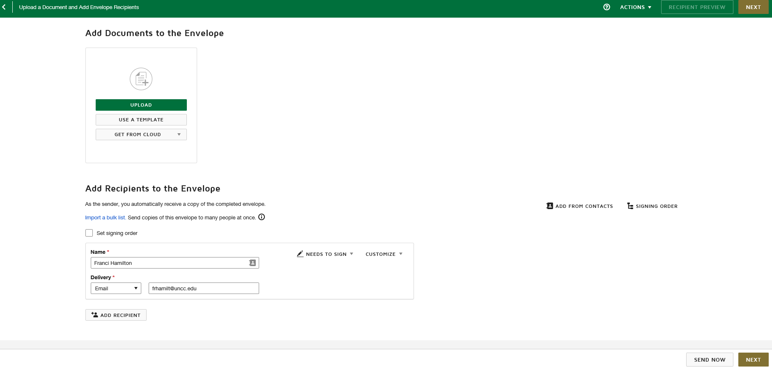
DocuSign
FAQ Page
https://spaces.charlotte.edu/
Link to sign in to DocuSign using Niner Credentials
https://docusign.uncc.edu/
Click the upload button or Drag and Drop the files to be loaded
Type in all the recipients needed and choose needs to sign or CC and pick the order with checking the signing order button
Click the Next gold button

Slide 17
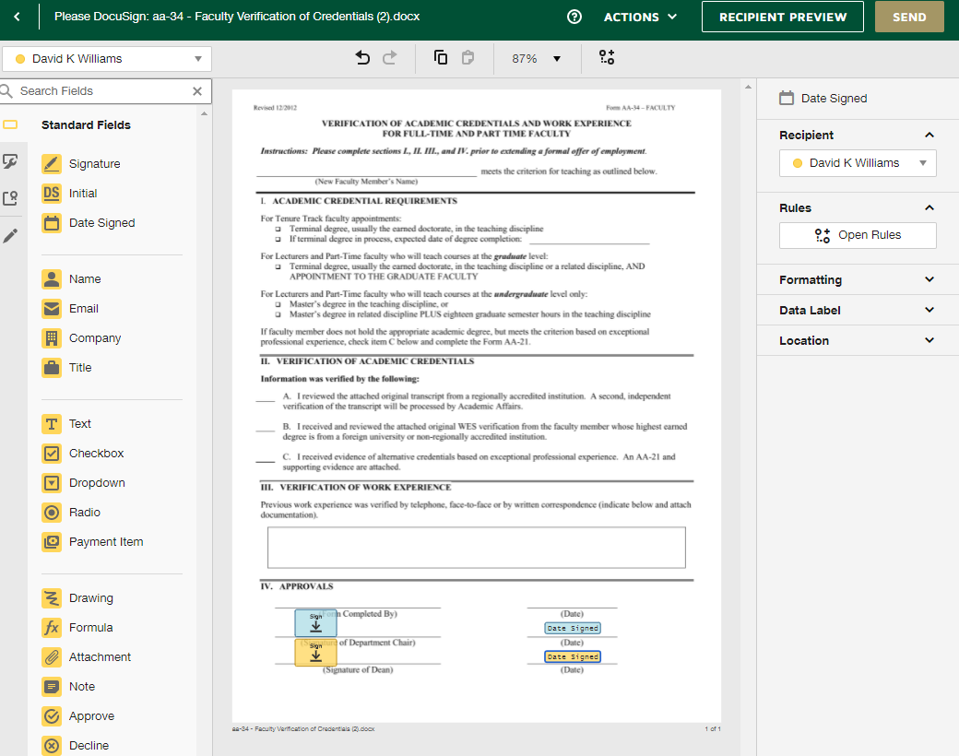
Placing Signatures in DocuSign and Sending
Click the signature and drag to the line where it needs to be placed
Grab the Date Signed and drop on the signature line
After placing the second signature the recipient box will show up and choose the correct name and blue color from the drop down for both the signature and date
Hit the send button when all signatures are added
Docusign Updates: Docusign accounts will be changed to NinerNet@charlotte.edu Friday, Feb. 28. There will be a Docusign outage from 5 p.m., Friday, Feb. 28, through 5 p.m., Sunday, March 2.

Slide 18
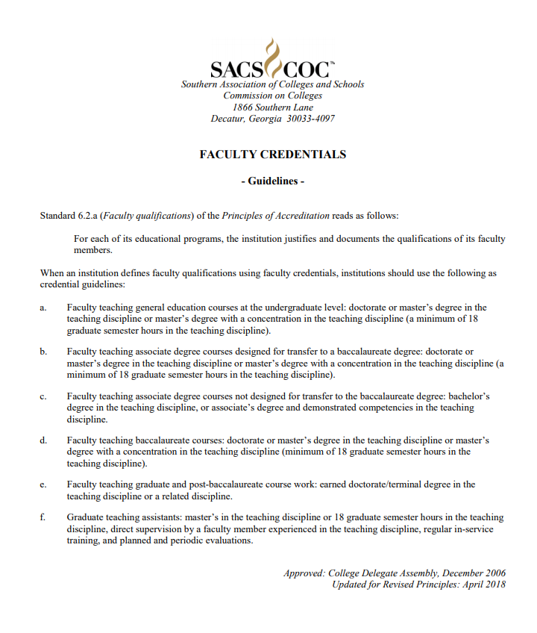
SACS 6.2.a Comprehensive Standard

Slide 19
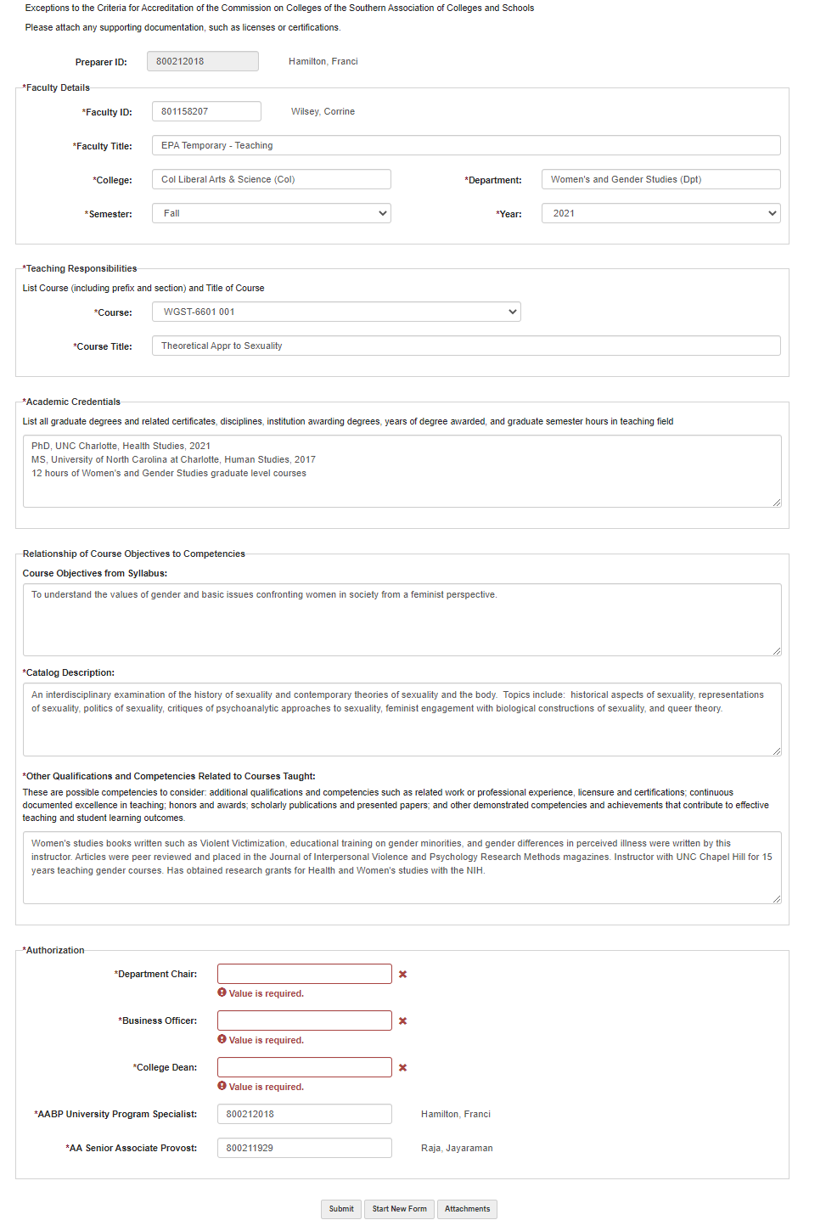
AA-21 – Exceptions to the Criteria for Accreditation Sample
Must use the correct 800# (form populates other data from Banner)
Must use the drop down for Semester and Year to populate the course the Faculty Member is teaching (form choices in drop down come from schedules keyed in Banner)
Free Fill Education and Course Objectives along with the (Other Qualifications to Qualify the hire to teach that course)
Catalog Description will auto populate
Authorizations (Use either 800# or Last Name, First Name to Populate field
Last 2 approvals should be Franci and Dr. Eric Heggestad
Heggestad, Eric

Slide 20
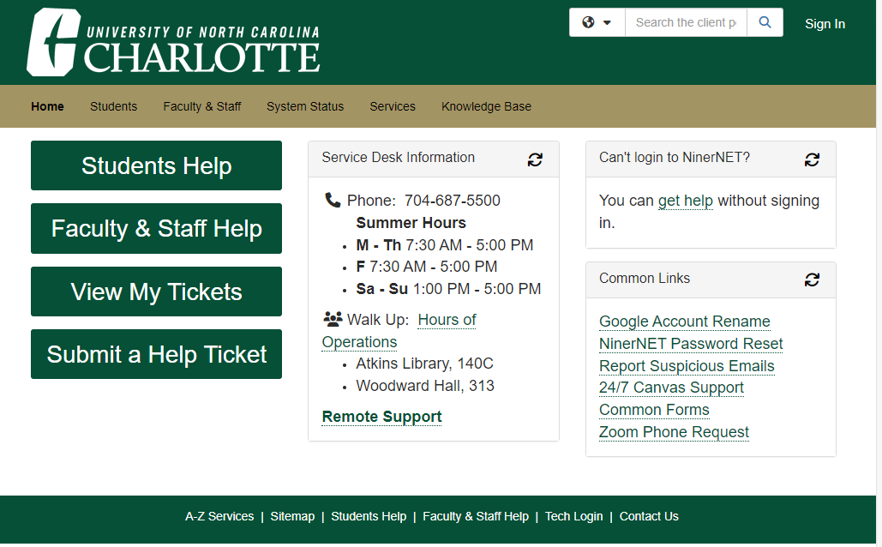
Technical Issues with the AA-21 or the AA-15 Form
Do not Use alias emails or @Charlotte.edu (Use for now @uncc.edu)
AA-21 (Exceptions to the Criteria for Accreditation of the Commission on Colleges of the Southern Association of Colleges and Schools)
    Image Now Help –
    By putting in a Ticket through IT Client Portal Home (charlotte.edu)
AA-15 Contract Powerform
    Image Now Help –
    By putting in a Ticket through IT Client Portal Home (charlotte.edu)

Slide 21
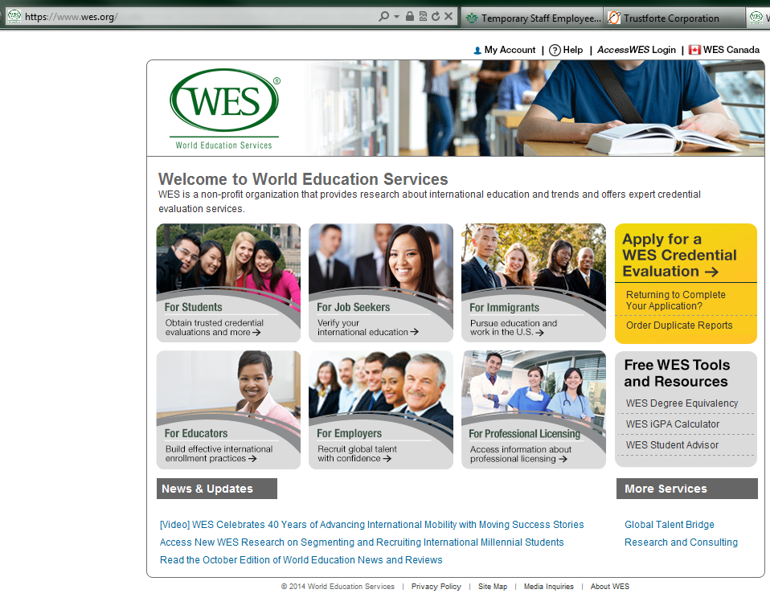
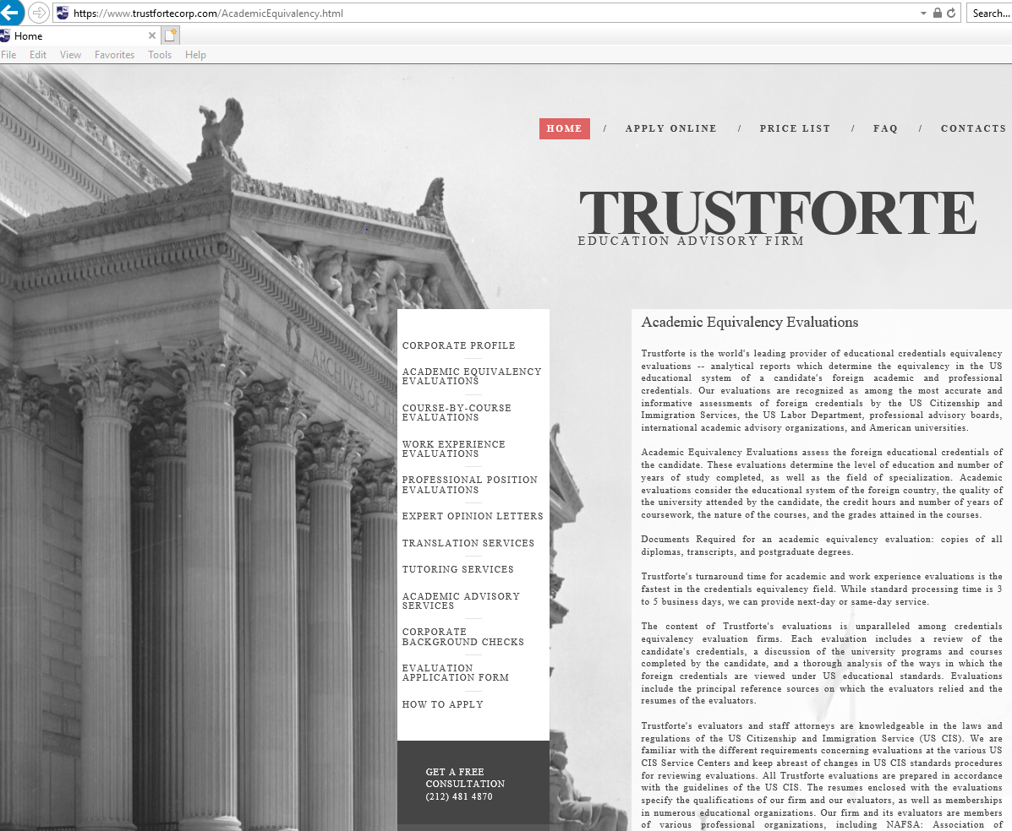
Foreign Degree Evaluation
https://www.wes.org/ or https://www.trustfortecorp.com/index.html

Slide 22
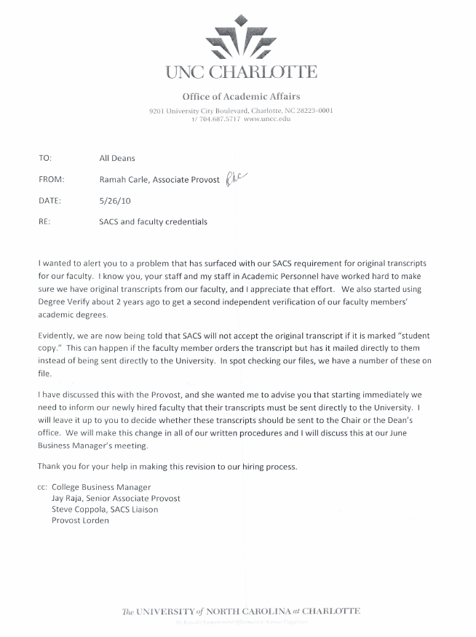
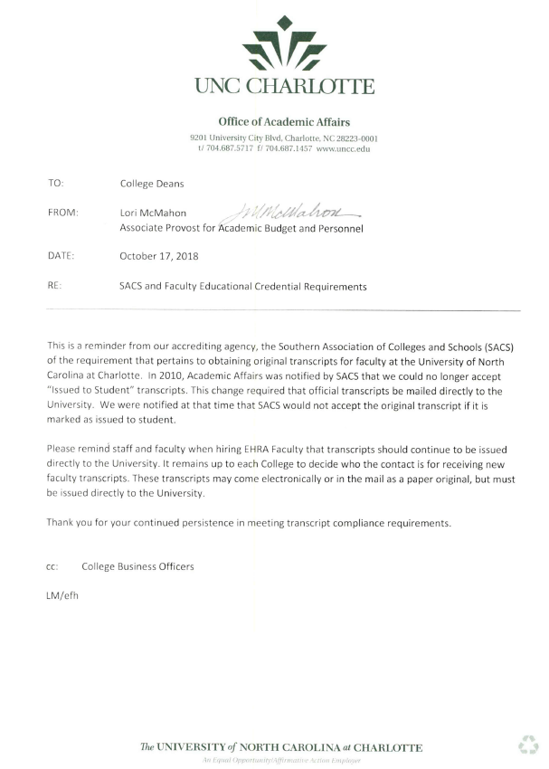
Transcripts should be Official and Original
(Not Issued to Student)

Slide 23
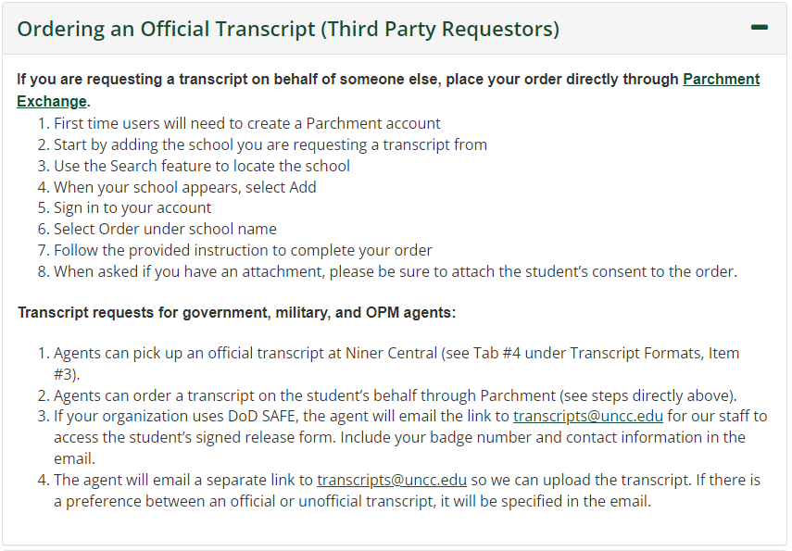
Transcript Ordering from UNC Charlotte Registrar’s Office
The link to order transcripts for UNC Charlotte Faculty.
https://ninercentral.charlotte.edu/grades-transcripts-graduation/order-transcripts
Email
Transcripts@charlotte.edu
If you have issues with ordering transcripts

Slide 24
Electronic Transcripts
Forward emails related to the electronic transcript to the College Business Manager, who will forward the emails to Academic Affairs faculty-recruit@charlotte.edu
These may be sent in 2 separate emails (one may be a link and the other may be the passcode).
Keep in mind there may be a limited number of times this document can be accessed.
An official electronic transcript should be transmitted directly from the issuing institution to the hiring department.

Slide 25
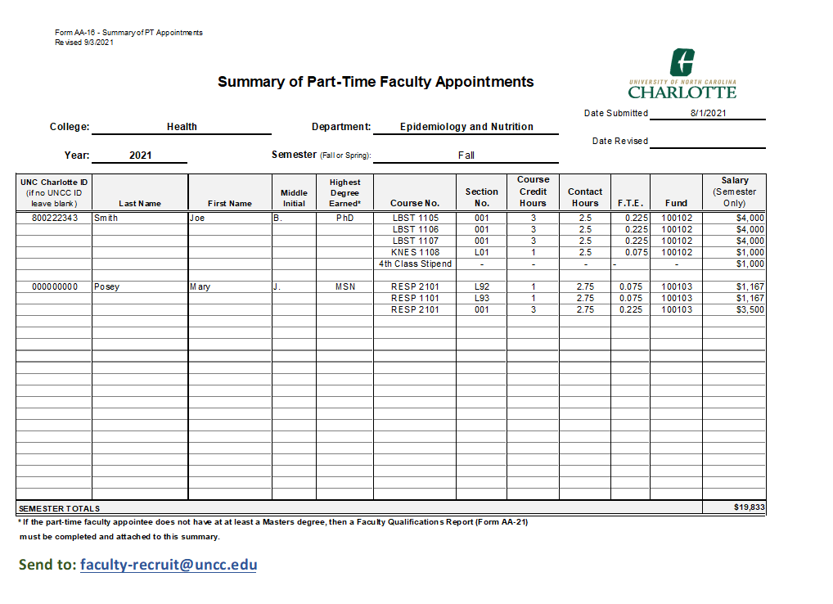
AA-16 Summary
Always use the most recent version
Send to: faculty-recruit@charlotte.edu

Slide 26
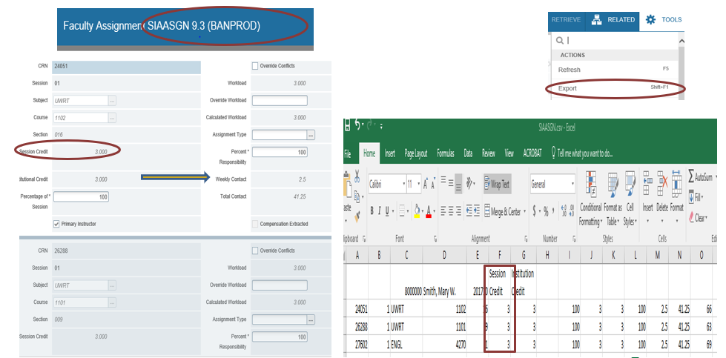
Banner - SIAASGN Screen
Shows all classes and Credit Hours for AA-16 Summaries

Slide 27
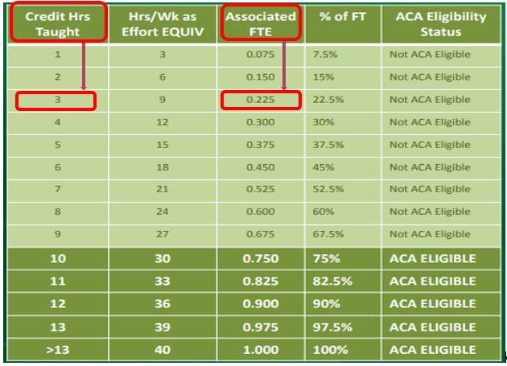
AA-16 Summary
FTE/Credit Hour Conversion Chart

Slide 28
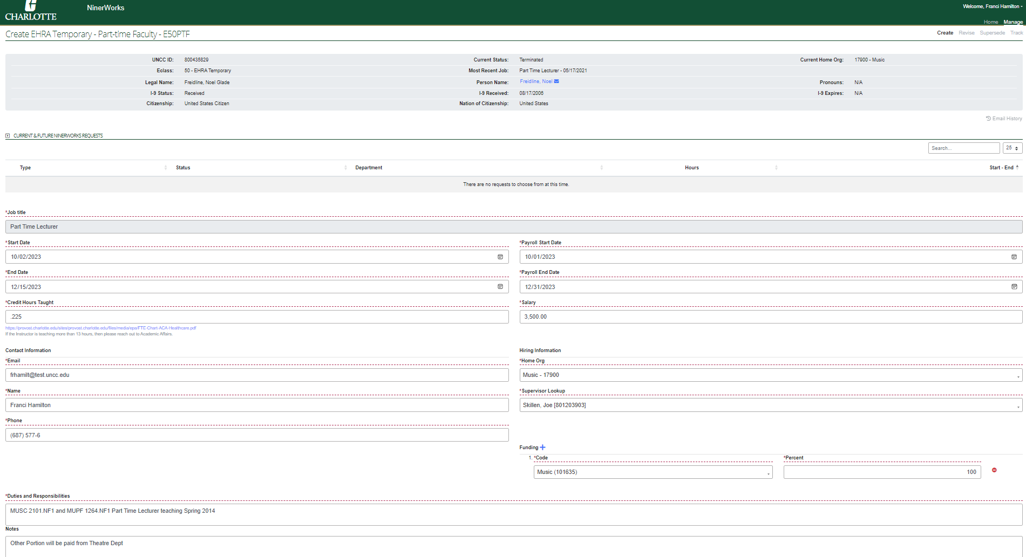
Payments for
Adjunct/Part-time Hiring
NinerWorks Sample
Create a NinerWorks Action https://ninerworks.charlotte.edu/ once the Part-Time Faculty Contract (AA-15) and Summaries (AA-16 submitted electronically in Excel file format to your Business Officer and the faculty recruitment email) are complete.
The NinerWorks Action is the payroll form.
NinerWorks Action - Initial payment and Supersede
PD7 – is only used for Postdocs teaching or Manual Entries for a FT that is going to be PT (Benefits Extend)
Pre-set dates are set shortly before each semester begins
Query Dates are Behind the scenes and Calculated based upon the date a payment is received as to the beginning of the pay period as either the 1st or the 16th
NinerWorks Access through the Learning and Development Portal FAQ on NInerWorks Training and Learning and Organizational Development Page for training on NinerWorks
12

Slide 29
Adjunct / Part-time Payment
Changes / Superseding
Updated AA-16 summary (submitted electronically in Excel file format) is required to show changes
Revised Faculty Contract (AA-15) is required with all original signatures
Superseding NinerWorks Action is required to change dates, salary, and a PD7 is used to Remove the Payment/Resign or for Postdocs teaching or Moving from FT to PT Manual Entry
  The PD7 should reference the previous NinerWorks Transaction and Position Number
If resigning, include email or letter stating reason for resignation

Slide 30
Superseding Instructions
Guidelines for Creating a Superseding NinerWorks or PD7 for Manual Entry and updated contract for Adjunct/Part-time
Use the new hire’s legal name
Include Department Name
Contract Date will be the day the semester starts (refer to the 5-year Academic Calendar). If you have questions regarding the contract start date, check with your College Business Officer.
When completing Section 3 of the PD7or NinerWorks Action for part-time faculty hires, the salary will always be an agreed upon amount paid over the pay periods listed either by semester or over the academic year.

Slide 31
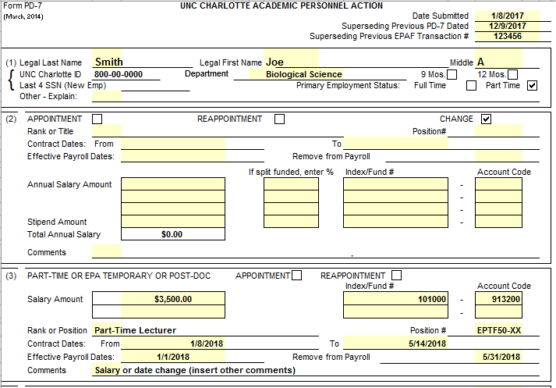
Payroll Distribution Form (PD7)
Sample superseding PD-7 for Adjunct/Part -Time Faculty Appointment Change
18223
Put in the Organization Code for the Hiring Department for Records Management
Put in the Reason for Change, Supervisor and 800# and the Total FTE for this Assignment

Slide 32

Payroll Distribution Form PD7
Adjunct/Part-time appointment PD7s should be signed in the requested block, by the Dean of the College and send to faculty-recruit@charlotte.edu
Academic Affairs will sign off as HR and have the Provost’s Delegated Authority sign in the Provost slot.
Dr. Jennifer Troyer is the Provost
*** Do not send your PD7’s to the Provost after Dean’s signature
(These Must go to faculty-recruit@charlotte.edu and for Part Time Faculty Franci will Sign as HR and Send to the Provost’s Signature authority for these actions)
Dr. Jennifer Troyer, Interim

Slide 33
Things to Remember from Today’s Workshop
Always use the most current forms from the Academic Affairs website
If the chosen candidate is a non-resident, contact the Director of the International Student/Scholar Office (ext. 7-7744)
Each Department should have an updated AA-16 summary submitted electronically in Excel file format each time a change is made
Official Transcripts must be sent directly to the University or through Official UNCC Email and not Issued to the New Hire Directly
NinerWorks Action or PD7 (For Postdocs Teaching/Separation) is used to make a change to dates or salary, and it must have a corresponding contract with changes, along with an Updated AA-16 Summary (submitted electronically).

Slide 34
        Please feel free to ask questions now or contact your College Business Officer.
Franci Hamilton – Academic Affairs
University Program Specialist and Part Time Faculty Coordinator
frhamilt@charlotte.edu, x75776

